Slide 1
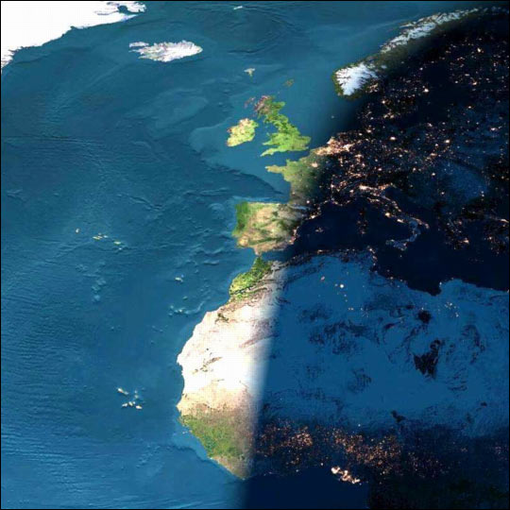
Welcome
Course II Science
Comprehensive
(Physical, Life, & Earth)
Mrs. Wilson
Room #436

Slide 2
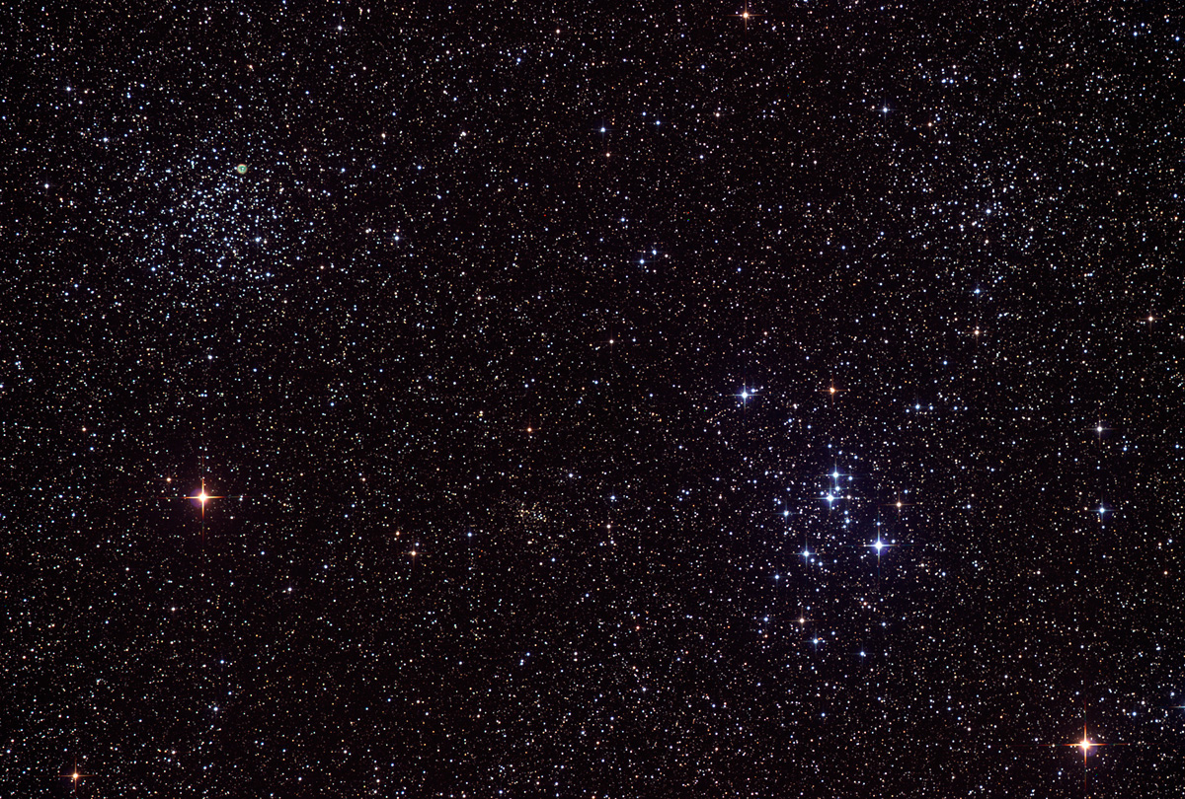
This year in Science Course II:
Students will learn various scientific investigation techniques.
Student studies will concentrate on:
  Describe principles of genetics, heredity, and diversity
  Ecology focusing on human impact
  Demonstrate knowledge of the forms of energy and energy transfer
  Explain how scientist study Earth’s past
.

Slide 3

Grading
Students' grades are bases on a percentage of total
points earned for the semester.
Tests 30%
Classwork/Homework 25%
Projects/Lab 25%
Quiz 20%

Slide 4
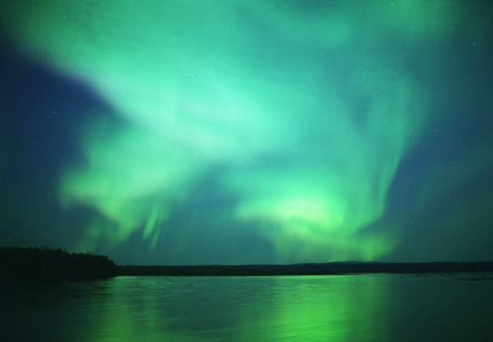
Late Work Policy
Complete/Correct homework on time = 100%
Complete/Correct homework turned in late = 50%
Students are responsible for getting make up assignments upon return
Make-up work must be turned in on time to be graded in accordance to the student handbook

Slide 5
Projects
All students will be required to complete an Experimental Research Assignment
  REGULAR: Will be completed in class with the teacher.
  ADVANCED: This will be due BEFORE Christmas Break (Dec. 5, board & binder)
  Phases of this project will be completed throughout the first semester, grades to be given in third quarter.

Slide 6

Technology
The use of the Chromebooks will be an integral part of the science curriculum.
Some projects will require students working outside of class hours.
Students not having computers to use at home may use school assets in the morning before school begins or assets available in the community.

Slide 7
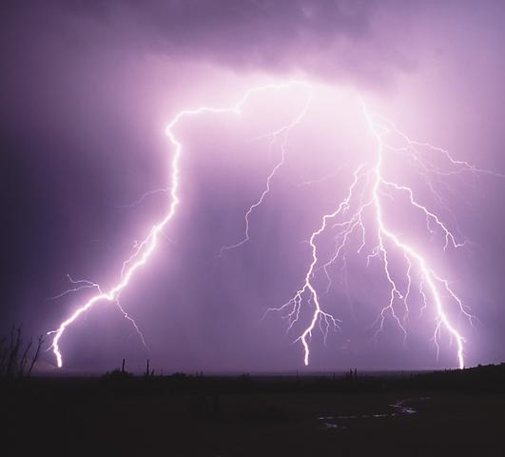


Electronic Resources
    Class Website:
    http://swilsonscience.weebly.com
To access the textbook online:
Students should log into the OneClay App and select resources. Find the Pearson button and select it.
To access the school website:
Go to http://olj.oneclay.net/

Slide 8
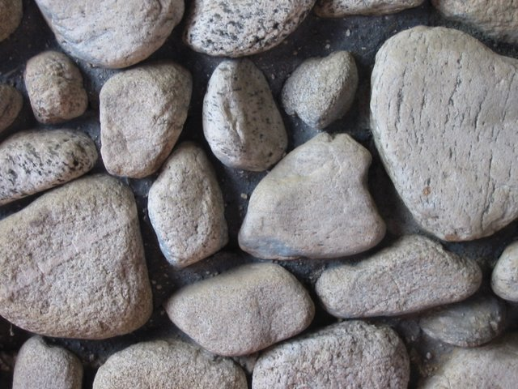
Tutoring
Will be available before school by request.
If you have and questions, comments, or concerns, please email or call:
stephany.wilson@myoneclay.net
(904) 213-5500 ext. 5571

Slide 9
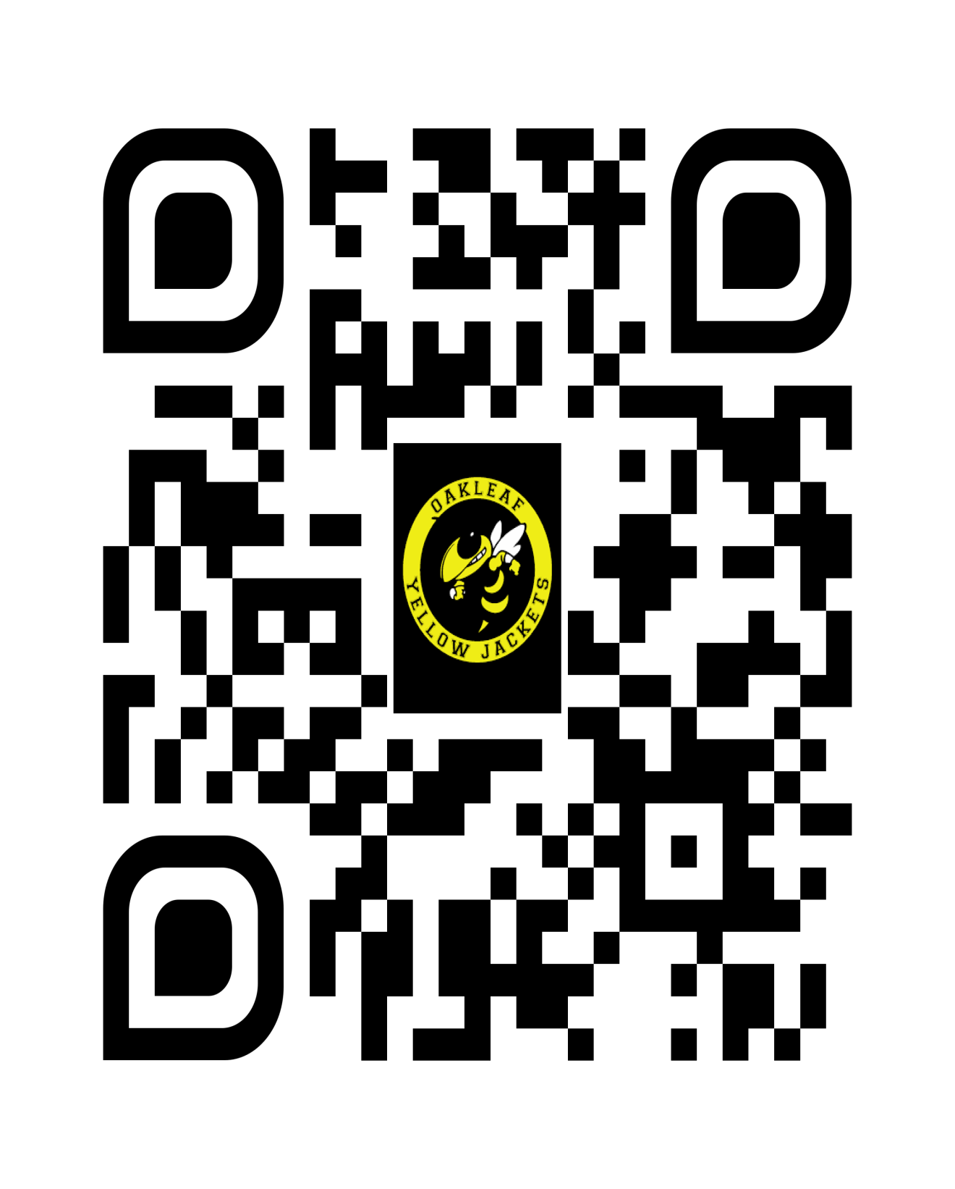
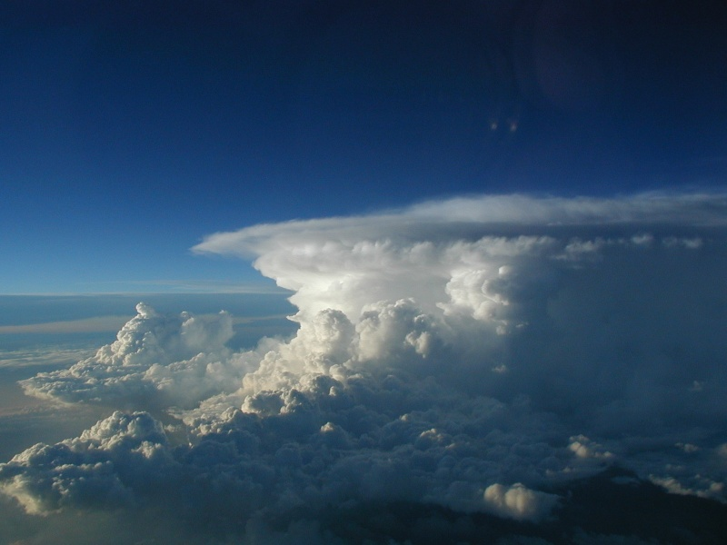
Want to be
“in the know” about
what is happening
here in Science?
Sign up for Remind!
Message sent to
your phone…and it’s
FREE!!!!!!

